Slide 1

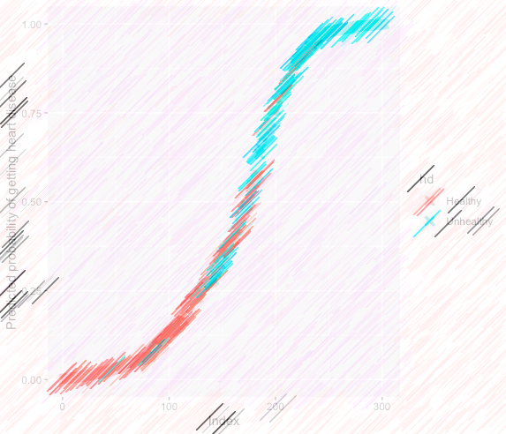
Heart Disease
Classification
ALY 6020_Predictive Analytics
Fall 2020 CPS Quarter
Instructor: Steward Huang, PhD
Yuyi Zhang
Oct 24, 2020

Slide 2
Content
Introduction
Method
Analysis
  Decision Tree
  Random Forest
  Logistic Model
Conclusions

Slide 3
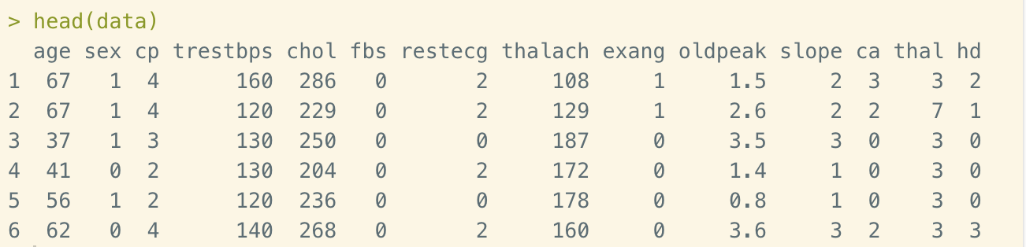
Introduction
Notes:
The Hear Disease data set contains 302 observations of 14 variables. The target variable is on the last column: hd. This is the diagnosis of patient whether they are healthy or unhealthy. We are going to use classification algorithm to predict the diagnosis based on 13 variables listed on the image.

Slide 4
Method
k-mean Nearest Neighbors (k-NN)
Naïve Bayes
Decision Tree
Random Forest
Logistic Model
Notes:
In this course, we’ve learned 5 classification algorithms. They are k-mean Nearest Neighbors (k-NN), Naïve Bayes, Decision Tree, Random Forest and Logistic Model.
In this report, we are going to go through the heart disease data set and classify the result of diagnosis by three different algorithms: Decision trees, Random forest, and Logistic model.
The Decision Trees build flowchart structures.
The Random forests are made out of decision trees. It combines the simplistic of Decision trees with flexibility resulting in vast improvement in accuracy.
Logistic model belongs to generalized linear model (GLM) family. It predicts True or False for the target variables rather than general linear models.
We are going to train these three models and compare their performance.

Slide 5
Analysis – Data Cleaning
Notes:
Import the data and add label on each column.
Now we from the variables that the absolute numbers of each column could be very different from others.
Especially there are many “0”s in some of the columns. This is not easy for k-NN since we need to normalize the numeric data.
The Naïve Bayes is more focus on text content rather than numeric data.
Thus in this case, we are going to use Decision tree, Random forest and Logistic model to solve the prediction of heart disease.

Slide 6
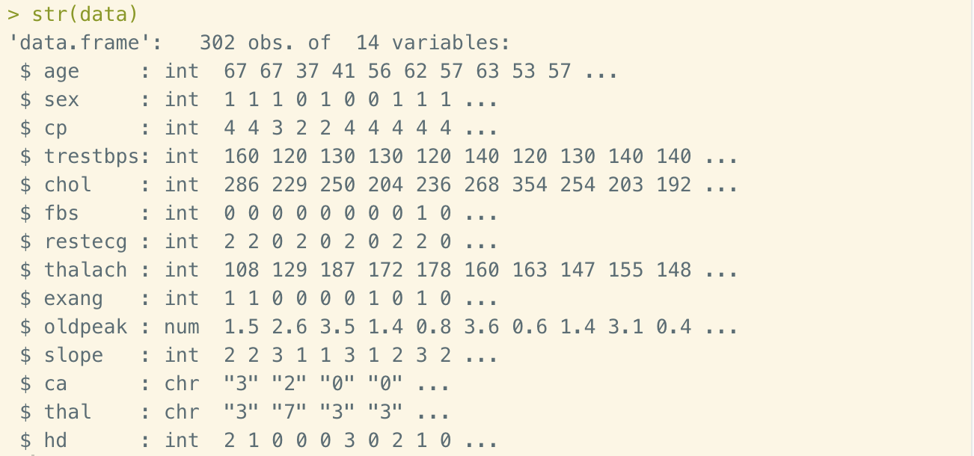
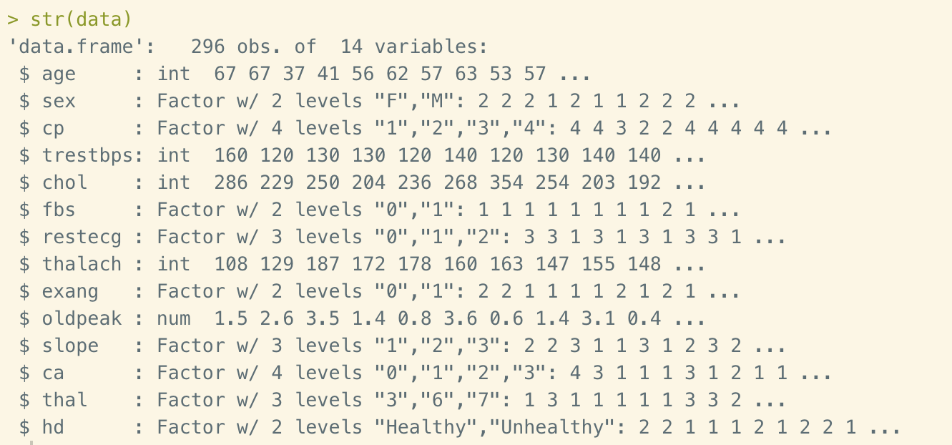
Analysis – Data Cleaning
Notes:
Before we dive into the model generating, let’s first clean up the data. The structure of data on the left.
Convert all “?” to “NA”s
Convert variables to factor levels
Find out missing data and delete them if the number of missing data is not large
Check out bias
Then we got the new structure on the right

Slide 7
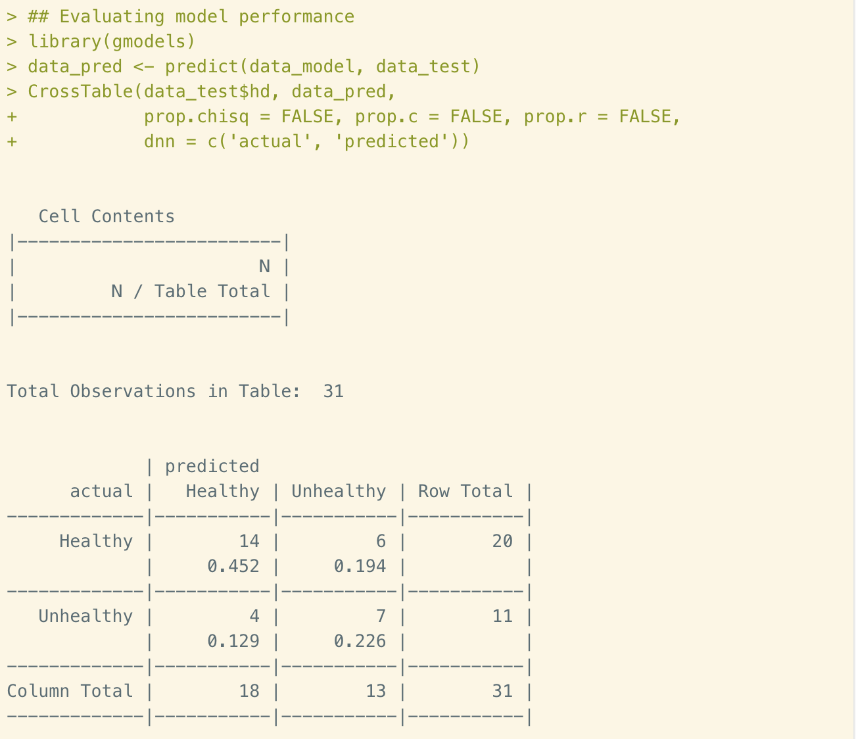
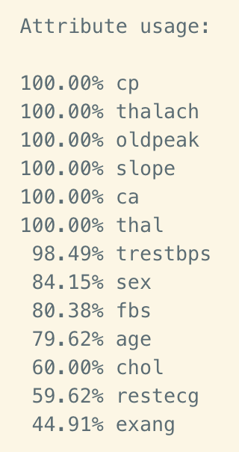
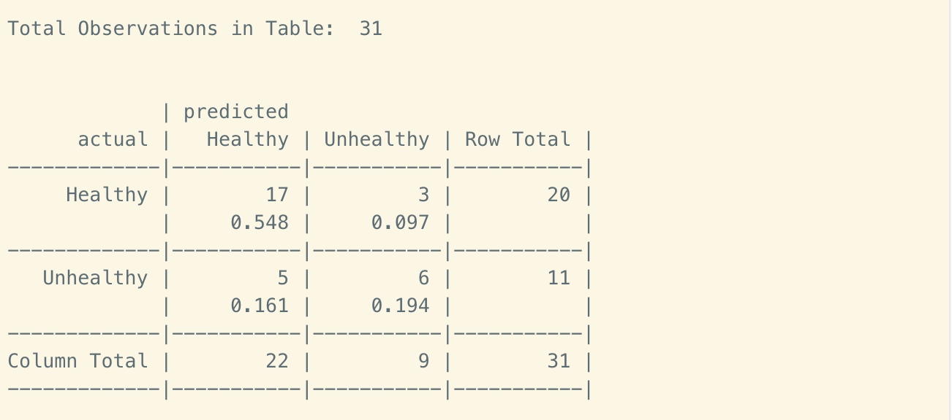
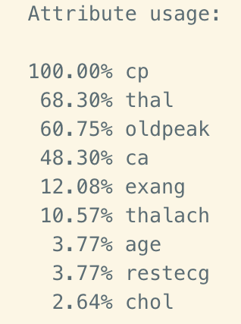
Analysis – Decision Tree
Notes:
Step 1: creating random training (900 variables) and test (100 variables) datasets
Step 2: training a model on the data. Use C5.0 function. The tree size that we’ve get is 12. In this page we could see that the 90.2% of training data are correctly classified, which is impressive. The confusion matrix showing how the 9.8% errors allocated.
Step 3: evaluating model performance. The test results are showing on the left-hand side. There are 31 observations in test data. The accuracy rate is about 68%, which is lower than training data. The false positive rate is 36%, which is relatively lower than false negative rate of 30%. Since the accuracy rate is low, this model needs to be improved.
Step 4: improving model performance. Using boost 10 vector by adding an additional trials parameter to limit the upper number of trees when it realized that no more trials were necessary. The improved model confusion matrix is shown on the right-hand side. The result of this adjusted model performs slightly better of the original. The accuracy rate is now 74% rather than 68%. But still lower than expected.

Slide 8
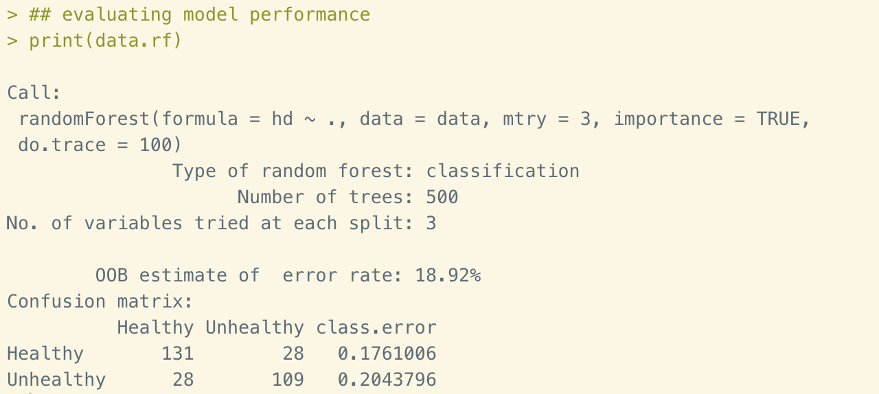
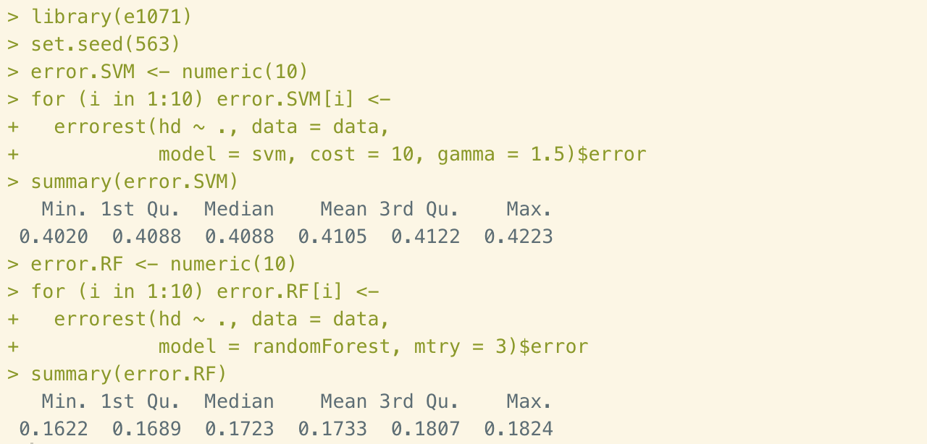
Analysis – Random Forest
Notes:
Step 1: training the model. We are going to use all the 13 variables to train the model. The number of trees is going to remain 500. The number of variables for each internal node is set to 3. The trace of each evaluation is set to 100. The OOB (stands for Out-Of_Bag) error rate indicating that estimation is improving by decreasing trend as low as 18.52%. The stay about number meaning that the estimate is as good as they are going to get.
Step 2: evaluating model performance. To evaluate the performance of the model, simply use print() function to get a confusion matrix shown on the left-hand side. The OOB error estimate of this model is 18.92%, which is much better than the result of Decision trees. The false positive rate is about 20%.
Step 3: Random forest and SVM comparison. In this step, we are going to compare the random forest with support vector machines (SVM). We are going to use 10 times 10-fold cross-validation to generate a vector called error.SVM. All the variables will be considered with cost equals to 10 and gamma equals to 1.5. From the two summaries we could see on the right-hand side, that Random forest returns much lower error rate than SVM. Therefore, the random forest compares favorably with SVM. So, the model of Random forest is better accepted in this case. The accuracy rate is 81.08%.

Slide 9
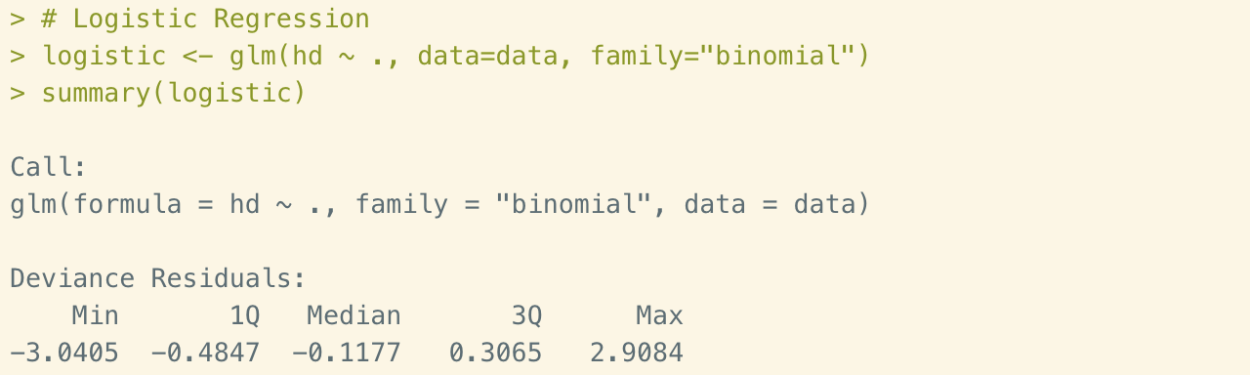
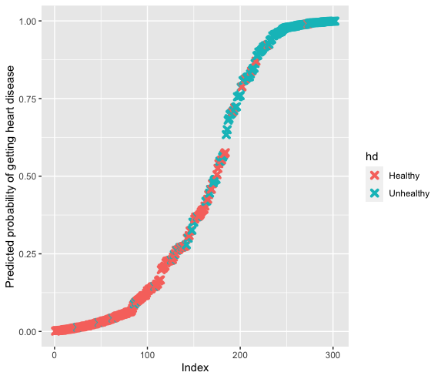
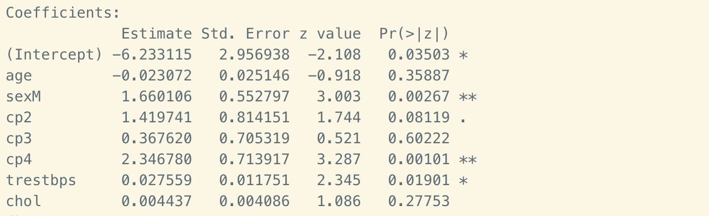
Logistic Model
Notes:
Step 1: training the logistic model and get the summary. The first line has the original call to the glm() function. This formula syntax, hd ~ ., meaning all of the variables are considered. The second line gives a summary of the deviance residuals. They look good since they are close to being centered on 0 and are roughly symmetrical.
The p-value of age is 0.36, which is much higher than 0.05. This indicates age isn’t a useful predictor. The median age in our dataset was 56, so most of the folks were pretty old and that explains why it wasn’t very useful. Gender on the other hand, is a good predictor since the p-value is 0.00267. A small p-value alone isn’t interesting, we also want large effect sizes, and that’s what the log(odds) and log(odds ratio) tells us.
Step 2: visualize the model. Most of the patients with heart disease in turquoise are predicted to have a high probability of having heart disease. And most of the patients without heart disease in pink are predicted to have a low probability of having heart disease. So, the logistic regression model has done a good job in prediction.

Slide 10
Conclusion
Decision Tree
Random Forest
Logistic Model
Notes:
In this report we practiced three classification methods, the Decision trees, Random forests, and Logistic regression model using the same data. We have choose these three methods out of the characteristic of our data. We used 13 variables to classify the status of heart disease whether the patient is healthy or unhealthy. In practice, healthy provider would spend lots of time to make diagnoses. With help from machine learning, the efficiency would be improved dramatically. After employing these three algorithms, we’ve got results of accuracy rate as 74%, 81%, and 52% respectively. Thus, the random forest could be a most accepted way to make the prediction.

Slide 11

The end
Notes:
In conclusion, all the 4 areas are residential. Data indicates increasing trend in A7 and C11 districts since 2015. Larceny cases from E5 and E18 districts reported at nights means people get robbed at home by the time of bed. These are considerable situation in the East Boston and southeastern area.

